Slide 1
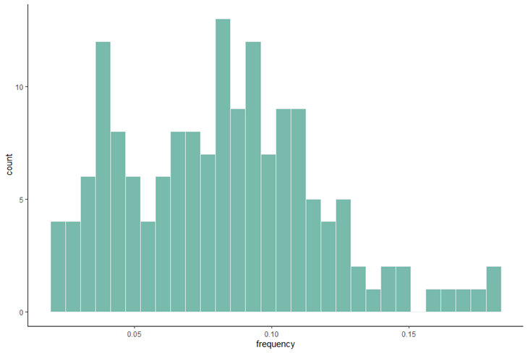
443 Goliath UV
# bins set to 30

Slide 2
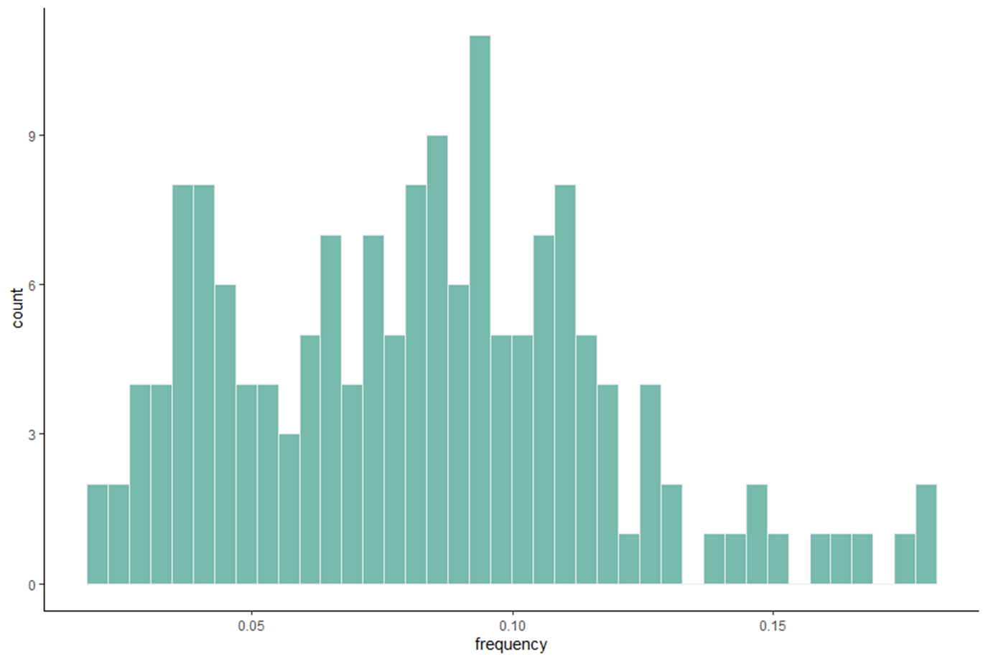
# bins set to 40

Slide 3
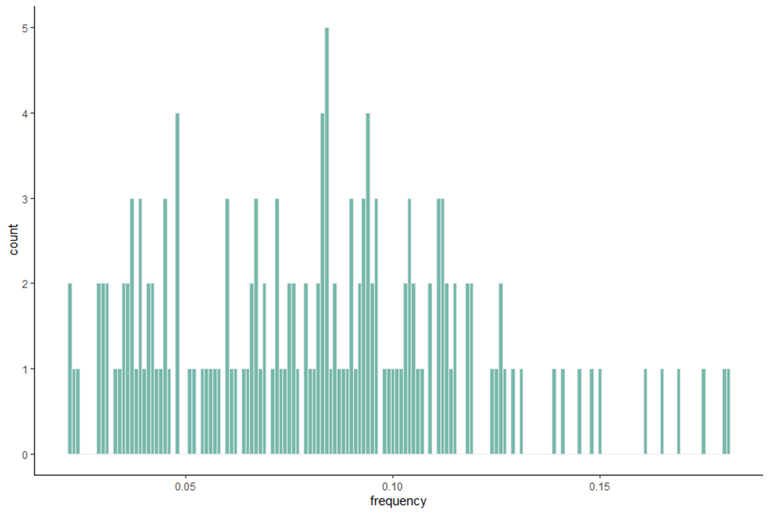
# bins set to 160

